Slide 1

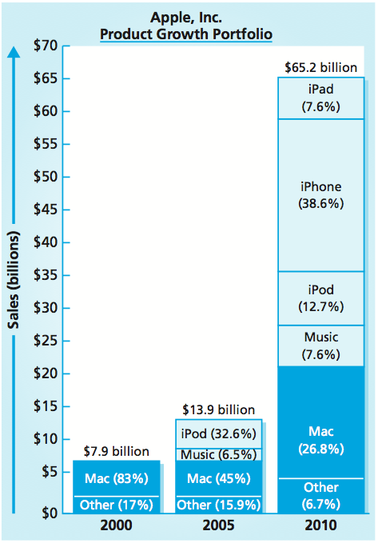
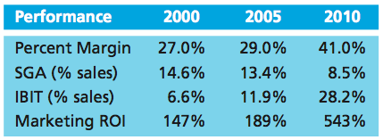
Offensive Strategies
MBM6
Chapter 12
Chapter 12
Offensive Strategic Market Plans
Investing to Grow Sales
Improving Competitive Position
Entering New Markets
When Growth Stalls
■ You miss 100 percent of the shots you don’t take.
—Wayne Gretsky
Copyright Roger J. Best, 2012

Slide 2
Offensive Strategies
MBM6
Chapter 12
Offensive Strategic Marketing Plans
In this section we will examine offensive strategies ranging from improving competitive advantage and market share in existing product-markets to entering a new market with no established share position.
Copyright Roger J. Best, 2012

Slide 3
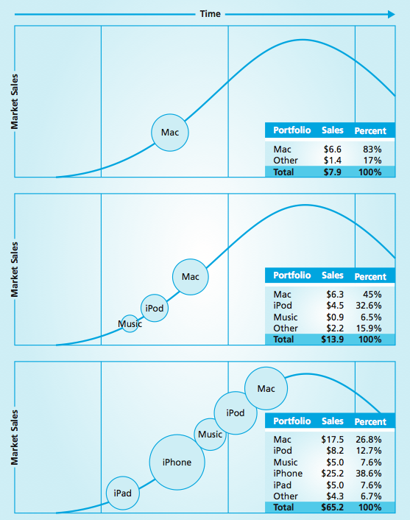
Product Life-Cycle Portfolio
MBM6
Chapter 12
The product portfolio for 2000 shows us that the Mac represented 83 percent of Apple’s sales.
By 2005 the iPod was responsible for 32.6 percent of sales, growing total sales revenue to almost $14B in 2005, despite the stagnation in Mac sales.
By 2010, the iPhone had overtaken Mac as the sales leader. The iPad had first-year sales of about $5B. Mac sales also tripled to $17.5B.
Copyright Roger J. Best, 2012

Slide 4
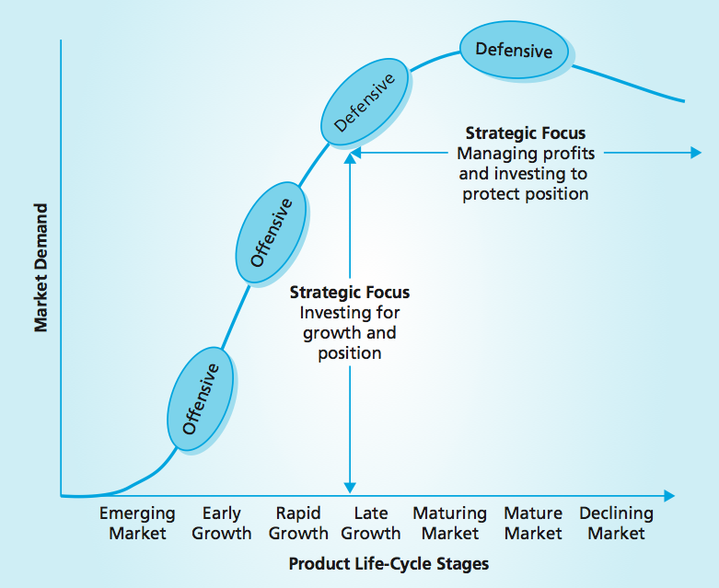
Offensive and Defensive Strategies
MBM6
Chapter 12
Offensive strategic market plans are usually growth oriented.
Defensive strategic market plans are more likely to be implemented in the latter stages of a product-market life cycle.
Copyright Roger J. Best, 2012

Slide 5
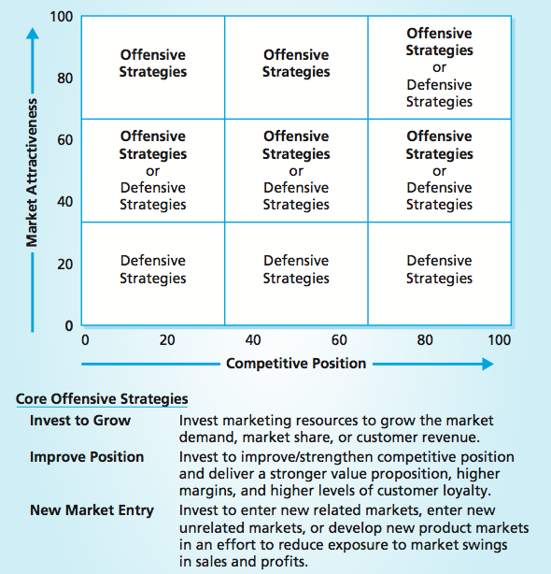
Portfolio Analysis and Strategic Market Plans
MBM6
Chapter 12
The combination of market attractiveness and competitive advantage creates a portfolio position for any given product-market.
Attractive markets are most likely to warrant an offensive strategic market plan to improve competitive advantage and share position.
Copyright Roger J. Best, 2012

Slide 6
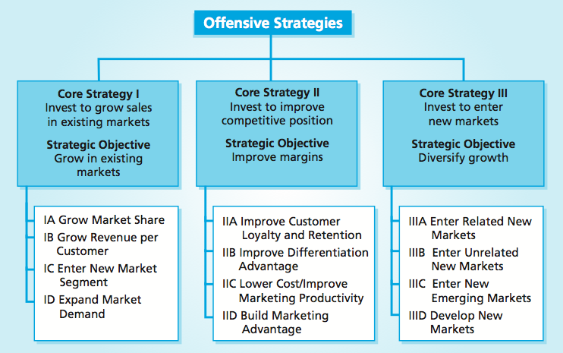
Strategic Market Plans & Offensive Strategies
Marketing Performance Tool 12.1
MBM6
Chapter 12
Offensive strategic market plans are fundamentally geared for growth and inherently involve strategies for penetrating or growing existing markets or entering or developing new markets.
Copyright Roger J. Best, 2012

Slide 7
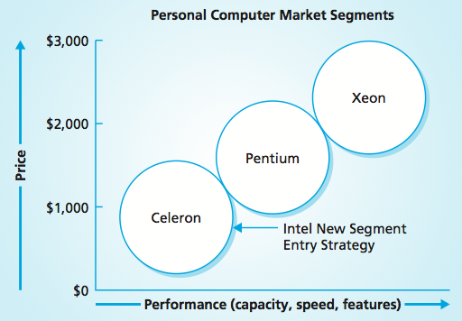
Intel’s New Segment Entry Strategy
MBM6
Chapter 12
Intel’s offensive strategic market plan for entering a new market segment gave the company a new source of sales revenue and profitability.
Copyright Roger J. Best, 2012

Slide 8
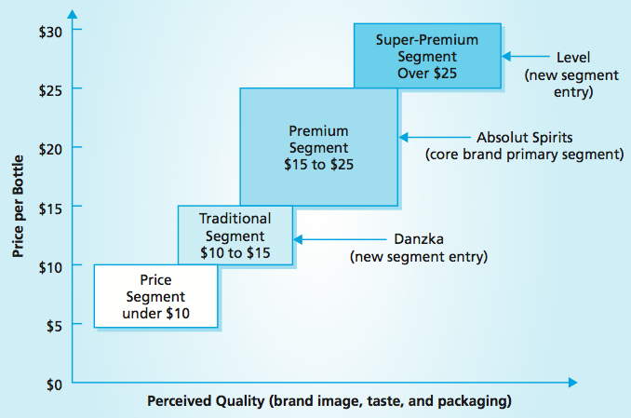
New Segment Offensive Growth Strategy
MBM6
Chapter 12
Another illustration of a company successfully entering new segments took place in the vodka market. This market is divided into four segments based on price and differences in taste, brand image, and packaging.
Copyright Roger J. Best, 2012

Slide 9
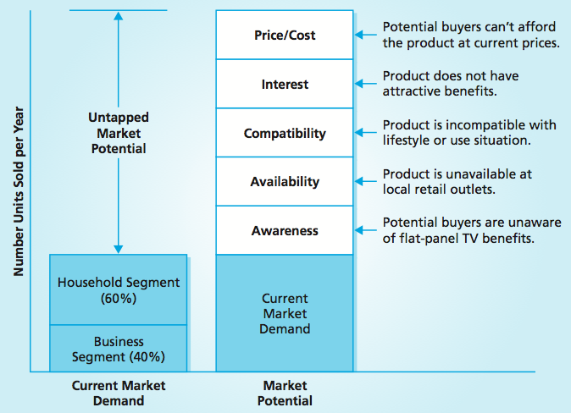
Growing Market Demand - Flat-Panel TVs
MBM6
Chapter 12
Five basic forces need to be addressed for the market to reach its full potential. A strategic market plan to grow either the entire market or a specific segment will carefully consider each of these forces.
Copyright Roger J. Best, 2012

Slide 10
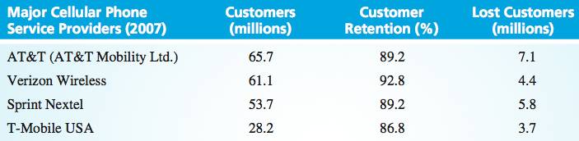
Customer Retention – Cell Phones
MBM6
Chapter 12
If businesses are not able to retain customers, they will experience higher marketing and sales expenses and lower marketing profits.
To hold its customer base, AT&T will have to acquire 7.1 million new customers. If AT&T could improve its customer retention rate to 94.2 percent, the company would increase the lifetime value of its customers by 25 percent.
Copyright Roger J. Best, 2012

Slide 11
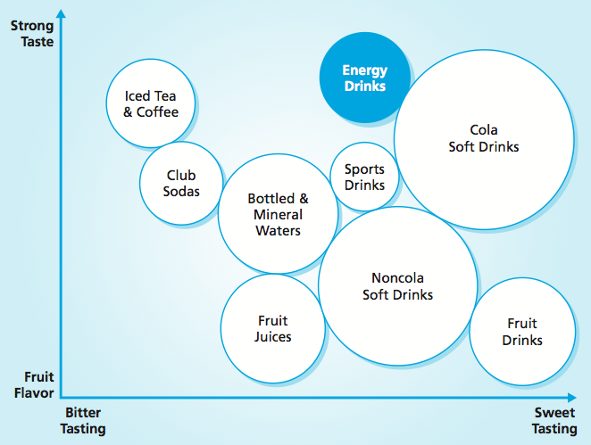
New Market Opportunities
MBM6
Chapter 12
With a 50 percent market share of the worldwide carbonated soft drink market, Coca-Cola has entered the $5 billion energy drinks market
As a result, Coca-Cola has developed new sources of sales growth by leveraging its core competencies and competitive advantages.
Copyright Roger J. Best, 2012

Slide 12
Offensive Strategies
MBM6
Chapter 12
When Growth Stalls
In this section we will examine how companies that encounter stalled growth—and sooner or later, most do—must immediately develop and implement a strategy to deal with it.
Copyright Roger J. Best, 2012

Slide 13
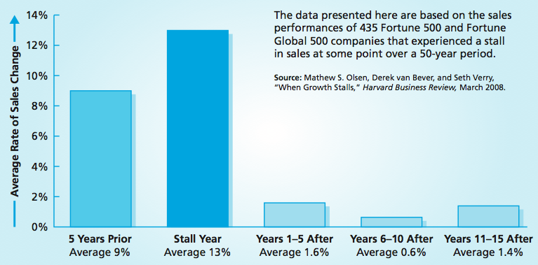
What Happens When Growth Stalls
MBM6
Chapter 12
Maintaining sales growth is difficult. A comprehensive study of 500 major U.S. and global companies found that, at some point, 87 percent of them over a 50-year period experienced a stall in their sales.
Copyright Roger J. Best, 2012

Slide 14
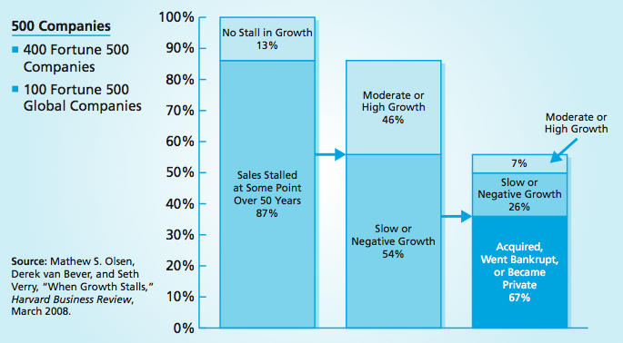
Sales Growth After Sales Stall
MBM6
Chapter 12
The most startling finding of the study was that two-thirds of the companies that experienced a stall ended up being acquired by other companies, filing for bankruptcy, or becoming privately held.
Copyright Roger J. Best, 2012

Slide 15
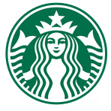
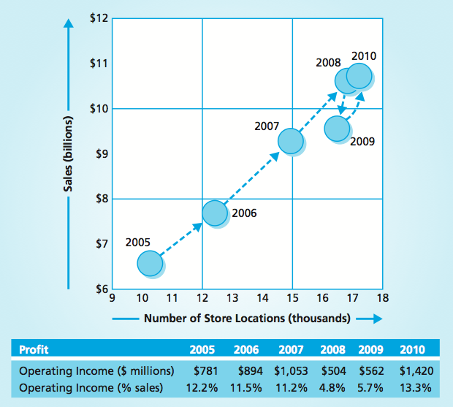
Sales Growth and Locations
MBM6
Chapter 12
Starbucks’ sales and the number of its stores have grown quickly over the years.
But in 2008, sales leveled off, prompting Starbucks to close some less profitable stores, lowering the worldwide number from 16,690 to 16,635.
Copyright Roger J. Best, 2012

Slide 16
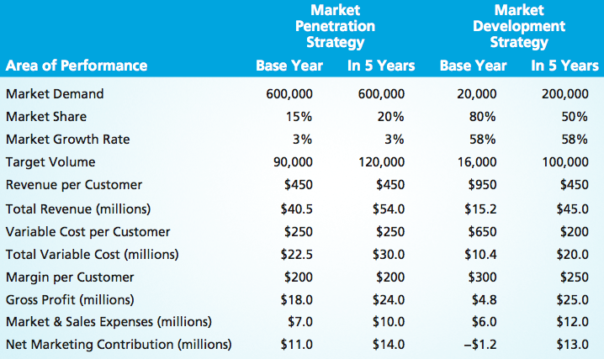
Alternative Offensive Market Plans
MBM6
Chapter 12
A business with a short-run need for better profit performance would be inclined to select the market penetration strategy shown here rather than choosing a long-run market development strategy.
Copyright Roger J. Best, 2012

